Slide 1
Introduction to
IT Project Management
Dr. Elshaimaa Ramadan
Teaching Assistants:
Rana Alaaeldin
Salwa Megahed
Sherrie Kareem
Tutorial 3
Spring Semester 2019
IT Project Management-Tutorial 3

Slide 2
What is Project Integration Management ?
IT Project Management-Tutorial 3

Slide 3
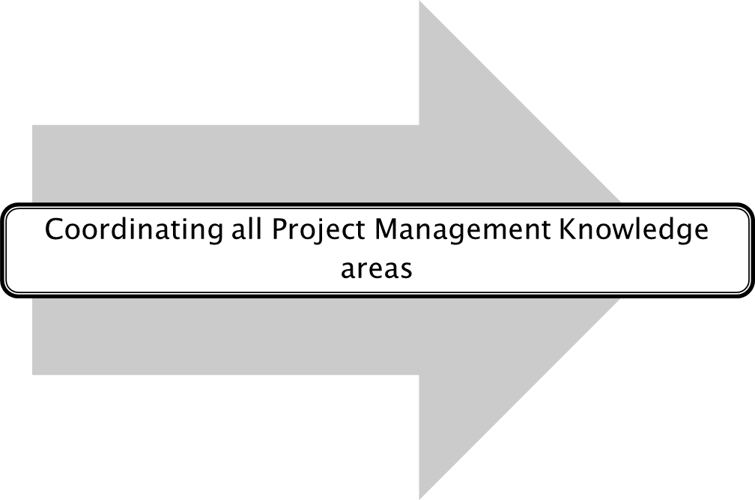
What is Project Integration Management ?
Project Start
Project Finish
IT Project Management-Tutorial 3

Slide 4

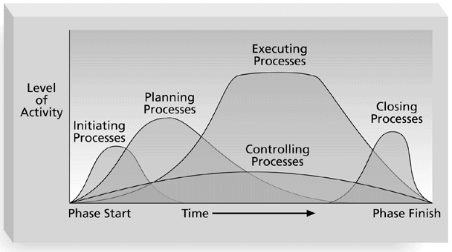
Project Management Process Group

Slide 5
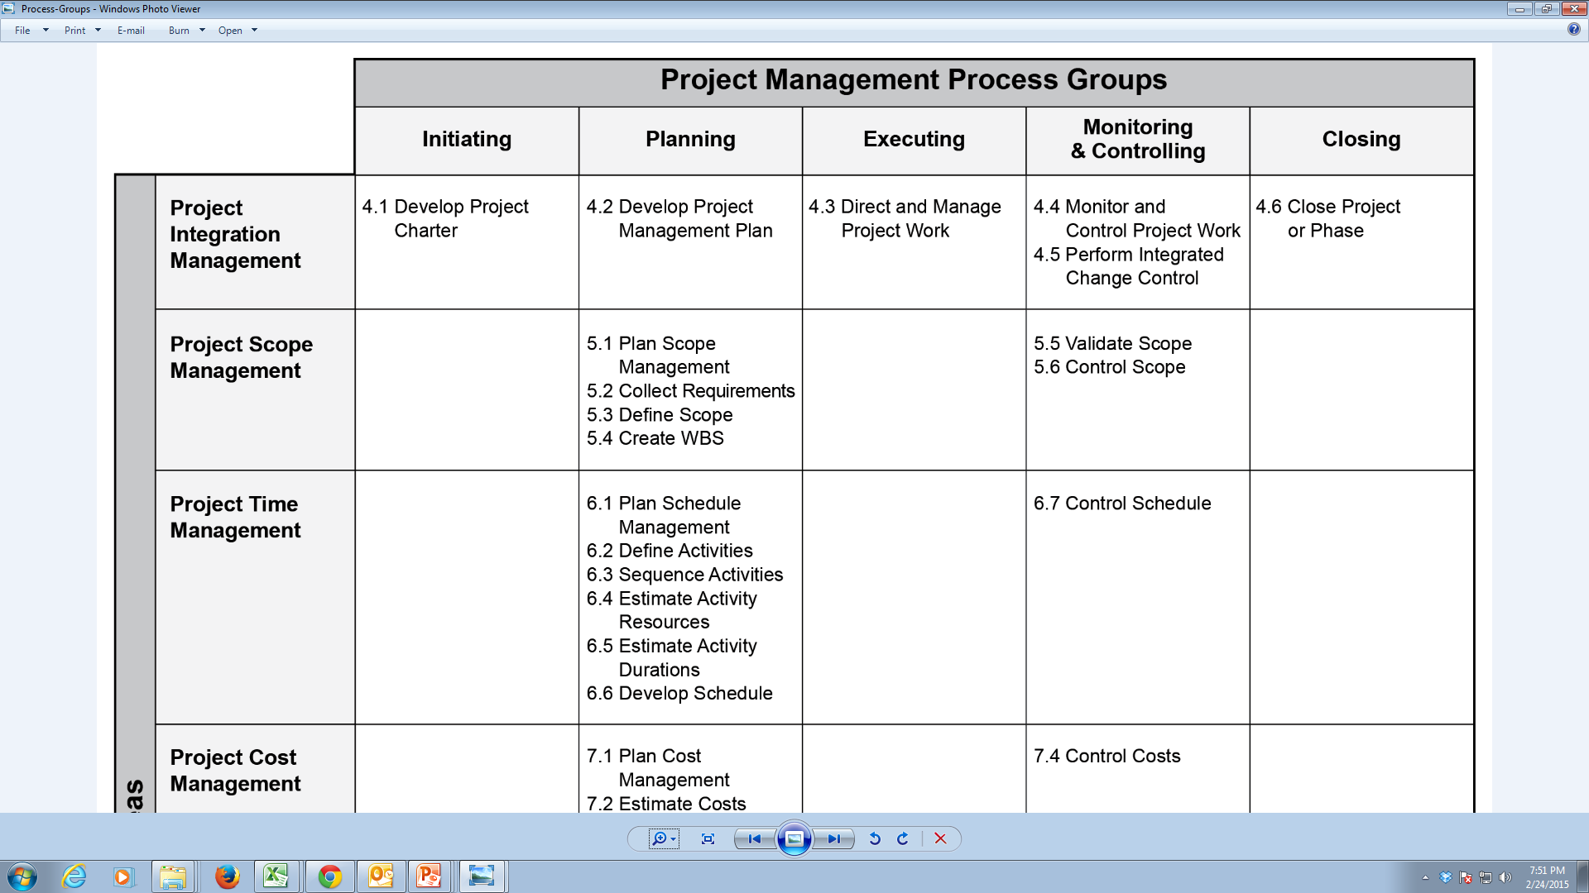
Knowledge areas VS Project Management process groups
IT Project Management-Tutorial 3

Slide 6
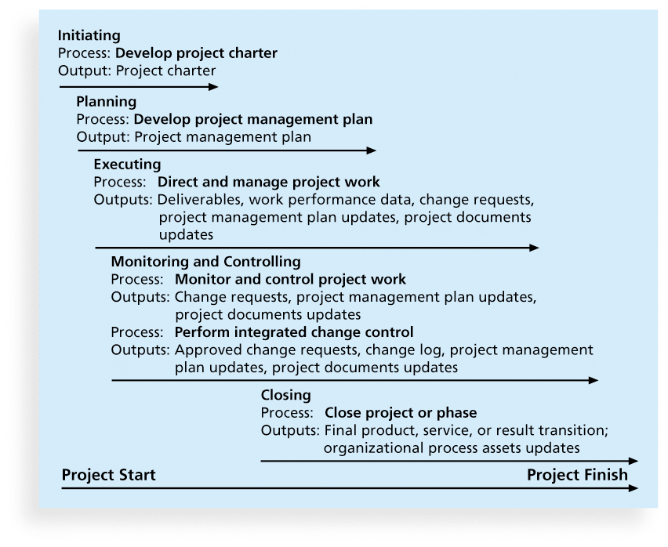
Project Integration Management main Processes:
IT Project Management-Tutorial 3

Slide 7
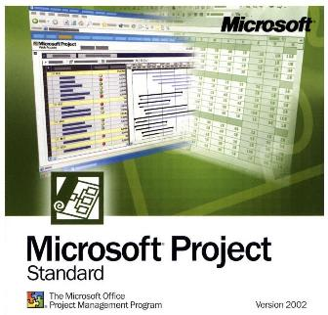
What is Microsoft Project ?
It is a software application used to plan and manage projects implemented in an organization.
Used to:
Better organize and manage work and people to ensure that projects are delivered on time and within budget
Enhance the productivity and effectiveness by learning and applying project management practices easily
IT Project Management-Tutorial 3

Slide 8
Important Terminologies:
Task: A project activity that has a starting and finishing point. A task is the basic building block of a project.
Summary task: A task that is made up of and summarizes the subtasks below it. In project, phases of project work are represented by summary tasks
Milestone: A significant event that is reached within the project or imposed upon the project. In Project, milestones are normally represented as tasks with zero duration.
Resource: People Equipment, materials or services that are needed to complete various tasks.
Relationships: The type of dependency between two tasks, visually indicated by a link line. Also known as a link, a logical relationship, a task dependency, or a precedence relationship.
IT Project Management-Tutorial 3

Slide 9

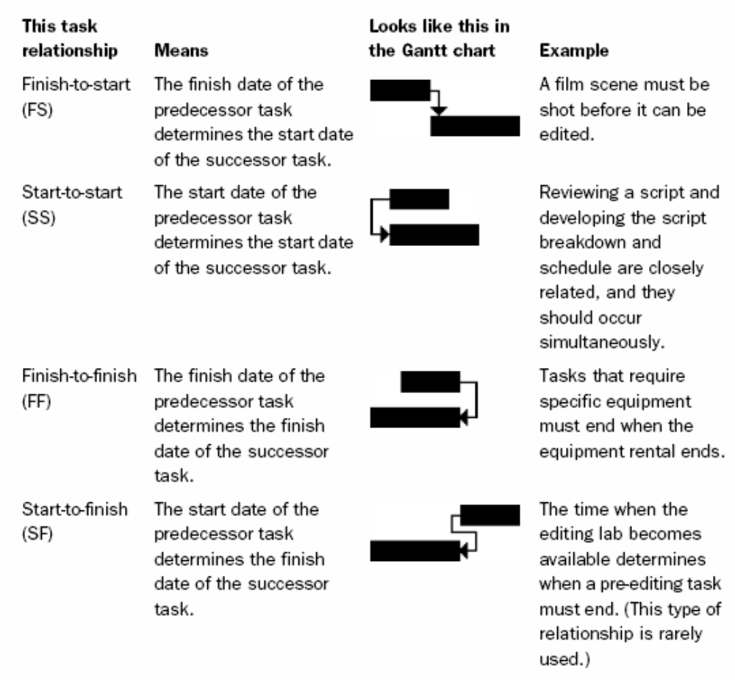

Slide 10
Exercise using MS Project !!
IT Project Management-Tutorial 3

